Slide 1
Stonks Gurus
Erik Prieto
Joe Vallikalam
Alex Manley
Christian Kunz

Slide 2
Background
We wanted to do a Machine Learning project that predicts future stock prices.
Not knowing the exact direction of the project led us pick up on ideas we had within our previous projects.
Important factor was the accessibility to data, either via download, api or even web scraping.
An interesting project from a previous session about the Bitcoin Transaction information as well as the news around the energy use of Blockchain technology was worth enough to take a look under the hood.
Predict the Performance of the Energy market

Slide 3
What can impact the Energy market?!?
Weather
We think that the weather has an impact on energy usage as well as on our decision making.
Higher temperature difference to the norm results in higher energy consumption
Blockchain Transaction
“A single bitcoin transaction uses roughly 707.6 kilowatt-hours of electrical energy - equivalent to the power consumed by an average U.S. household over 24 days”
Commodities
Supply and Demand of crude oil and natural gas

Slide 4


Getting the Data
We started with 72 data points/features...
1 Weather temp
8 Bitcoin
28 Commodities
35 Energy ETF
...and ended up with 27 data points/features.

Slide 5

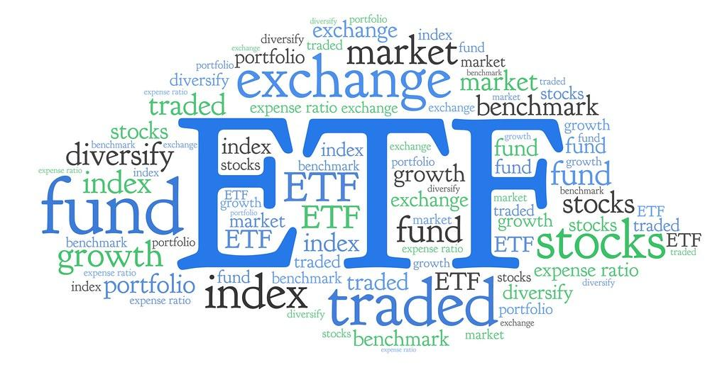
Know Your ETFs
What is an ETF?
ETF stands for Exchange Traded Fund
A Marketable Security that tracks a stock, index, bond, commodities, etc.
Concept similar to mutual fund
Different assets all pooled together
Offset risk through diversification
Main difference between Mutual Funds & ETFs
ETFs are traded on exchanges
Prices fluctuate all day (mutual funds close once after market close)

Slide 6
Know Your ETFs
iShares Global Clean Energy ETF (ICLN)
Top 10 Holdings (48.3% of Assets):
Vestas Wind Systems A/S VWS 7.93%
Enphase Energy Inc ENPH 6.63%
Orsted A/S ORSTED 5.83%
Plug Power Inc PLUG 4.81%
Xcel Energy Inc XEL 4.14%
NextEra Energy Inc NEE 4.05%
SolarEdge Technologies Inc SEDG 3.99%
Iberdrola SA IBE.BC 3.95%
Enel SpA ENEL.MI 3.89%
SSE PLC SSE.L 3.04%
Fidelity MSCI Utilities Index ETF (FUTY)
Top 10 Holdings (54.2% of Assets):
NextEra Energy Inc NEE 13.82%
Duke Energy Corp DUK 7.30%
Southern Co SO 6.15%
Dominion Energy Inc D 5.70%
Exelon Corp EXC 4.16%
American Electric Power AEP 4.04%
Sempra Energy SRE 4.04%
Xcel Energy Inc XEL 3.41%
Public Service Enterprise PEG 2.91%
WEC Energy Group Inc WEC 2.70%
Invesco S&P 500 Equal Weight Utilities (RYU)
Top 10 Holdings (36.9% of Assets):
NRG Energy Inc NRG 4.02%
The AES Corp AES 3.75%
American Electric Power AEP 3.72%
Edison International EIX 3.71%
NextEra Energy Inc NEE 3.71%
CMS Energy Corp CMS 3.63%
Duke Energy Corp DUK 3.61%
Eversource Energy ES 3.61%
Public Service Enterprise PEG 3.60%
American Water Works AWK 3.58%
*Holdings information summary sourced from Yahoo Finance

Slide 7
Know Your ETFs
Utilities Select Sector SPDR Fund (XLU)
Top 10 Holdings (63.2% of Assets):
NextEra Energy Inc NEE 16.10%
Duke Energy Corp DUK 8.51%
Southern Co SO 7.18%
Dominion Energy Inc D 6.65%
Exelon Corp EXC 4.85%
American Electric Power AEP 4.74%
Sempra Energy SRE 4.68%
Xcel Energy Inc XEL 3.97%
Public Service Enterprise PEG 3.38%
WEC Energy Group Inc WEC 3.14%
Vanguard Utilities Index Fund ETF Shares (VPU)
Top 10 Holdings (54.6% of Assets):
NextEra Energy Inc NEE 13.59%
Duke Energy Corp DUK 7.29%
Southern Co SO 6.39%
Dominion Energy Inc D 5.81%
Exelon Corp EXC 4.17%
American Electric Power AEP 4.04%
Sempra Energy SRE 3.89%
Xcel Energy Inc XEL 3.61%
Public Service Enterprise PEG 2.98%
WEC Energy Group Inc WEC 2.80%
*Holdings information summary sourced from Yahoo Finance

Slide 8
Approach
Linear Regression
Baseline model. Should give us good indication about the relationship of the data points.
LSTM
Expectation is that the LSTM should perform better as our baseline model due to better fit to our thesis.
ARIMA
The ARIMA model should perform good as well due to its simplicity and use for time series data and past performance to predict future performance

Slide 9
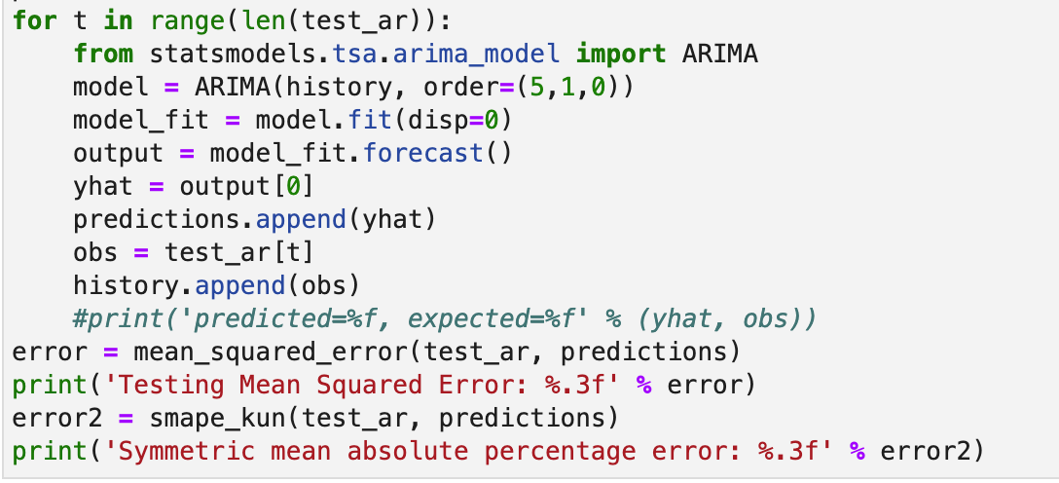
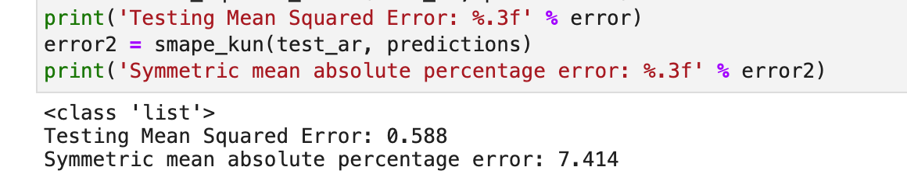
ARIMA Model
One of the ML models we tried was and ARIMA model (model identification, defining parameters and model checking)
As we all know ARIMA models are known as a great forecasting tool because it takes the previous close price of a stock to predict future prices (in the short term)
One drawback we found was that it would be able to predict individual returns, but then we couldn’t overlay them to see correlations

Slide 10
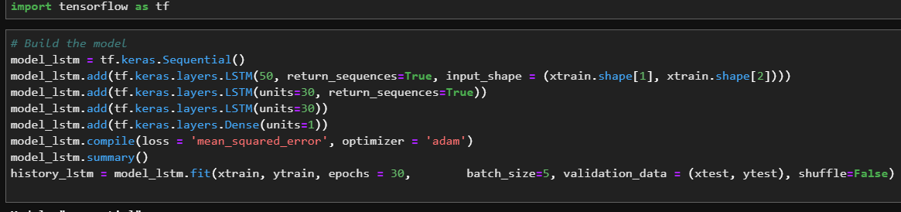
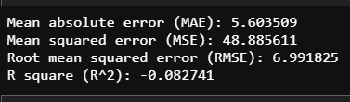
LSTM Model - A Constant Disappointment
Several attempts were unsuccessfully
Tried different variations on batch sizes, number of epochs, etc.
Consistently saw model fail in making predictions on test data
Low to negative R2 indicates model is not predictive of future stock prices

Slide 11
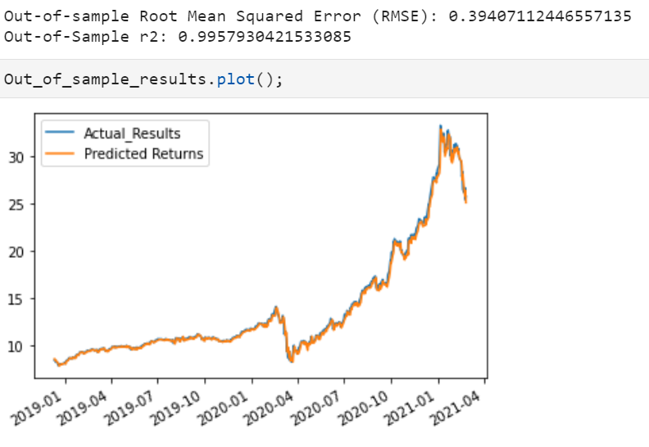
Linear Regression Model - Back to Basics
After tweaking, the sklearn Linear Regression model started making optimal predictions.
Added additional feature optimization component to improve stock price predictability by using less features and by incorporating the most relevant features.

Slide 12
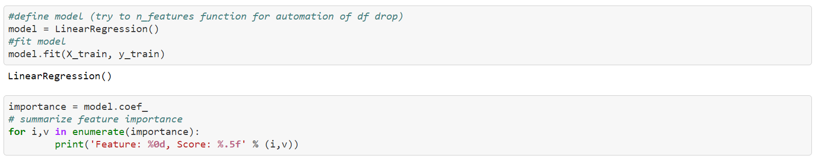
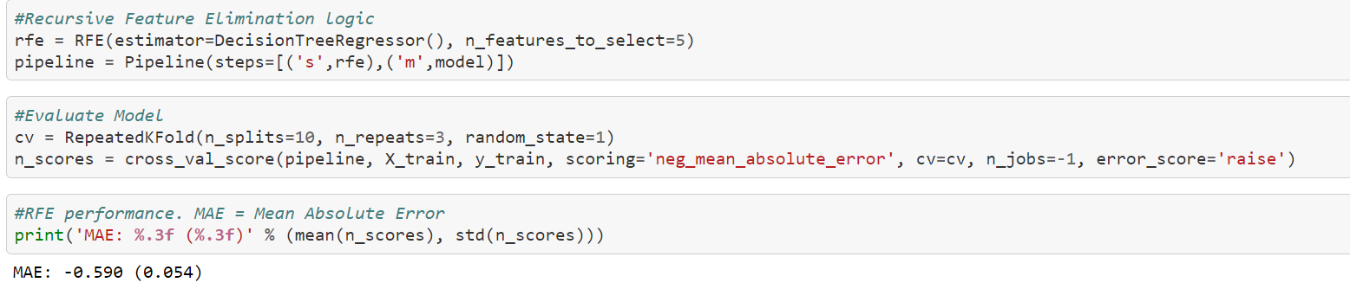
Linear Regression Model - Back to Basics
https://machinelearningmastery.com/rfe-feature-selection-in-python/

Slide 13
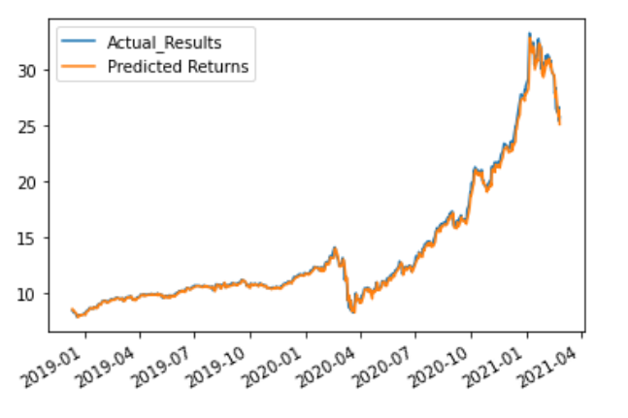
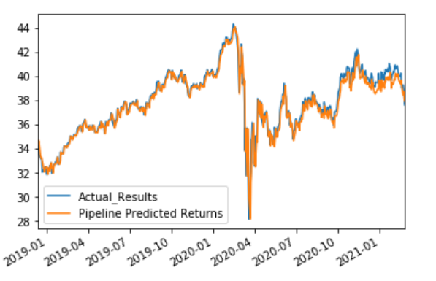
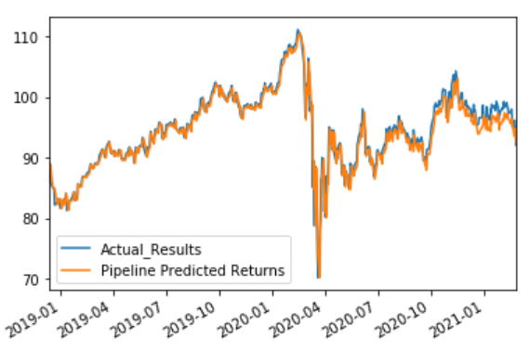
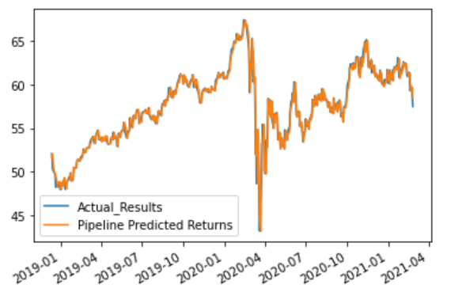
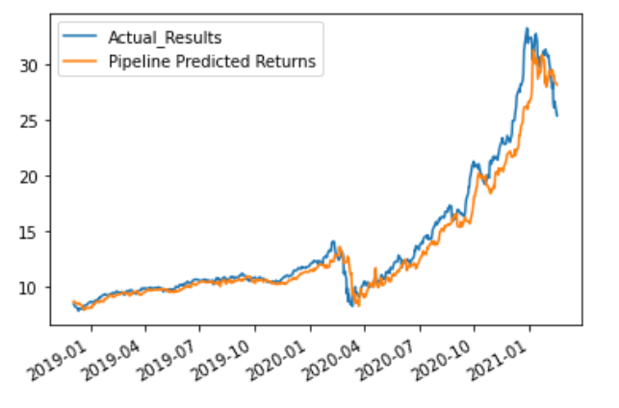
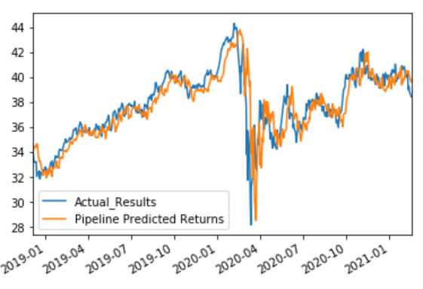
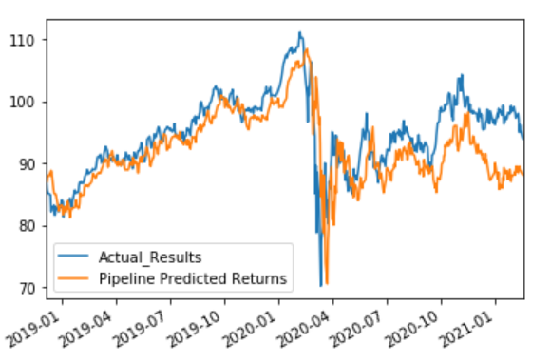
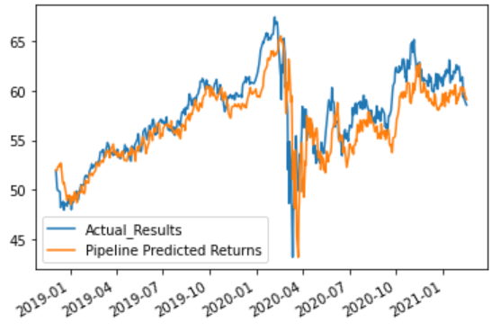
Linear Regression - Results Summary
ICLN
FUTY
RYU
XLU
1 DAY Optimal Feature Set
7 DAY Optimal Feature Set
Test Data R^2 | 1 Day Out | 7 Days Out
27 Features | 99.58 | 93.7
5 Features | 99.61 | 94.49
Test Data R^2 | 1 Day Out | 7 Days Out
27 Features | 93.84 | 30.75
5 Features | 93.56 | 72.22
Test Data R^2 | 1 Day Out | 7 Days Out
27 Features | 92.66 | 14.60
5 Features | 92.42 | 38.19
Test Data R^2 | 1 Day Out | 7 Days Out
27 Features | 94.23 | 33.82
5 Features | 94.95 | 66.36
R2 Analysis:

Slide 14
How to improve/what more to add
Model Tweaks:
Mix linear regression model with LSTM/ARIMA to achieve further accuracy boost for 7 day window predictions
Adjust hyperparameters and feature selections to improve model outputs
Visualize:
Introduce visualizations for easy information consumption from the model outputs
Invest:
Extend linear regression model analysis with buy/sell logic and P&L impact
Analysis:
Becoming industry experts to fine tune models even further
Other Applications:
Apply model to other industries, segments, and countries

Slide 15
Conclusion
Optimistic in machine learning potential to predict utility ETFs. Ours is a good starting point, but more industry knowledge, machine learning wisdom, and time is required before bets are placed.
Utilities ETFs somewhat predictable, but more testing needed
Commodities and Utility ETF prices high in feature importance values across models
Bitcoin activity demonstrated ~2% coefficient importance across models
Weather did not indicate as much as an influence as anticipated
More Features is not necessarily better due to risk of overfitting

Slide 16
Questions?

